Slide 1





WiDir: A Wireless-Enabled Directory Cache Coherence Protocol
Antonio Franques¹ (franque2@illinois.edu),
Apostolos Kokolis¹, Sergi Abadal², Vimuth Fernando¹, Sasa Misailovic¹, Josep Torrellas¹
¹University of Illinois at Urbana-Champaign
² Universitat Politècnica de Catalunya
CCF-1629431
863337 (WiPLASH)
Notes:
Hello, my name is Antonio Franques and today I will be presenting WiDir: A Wireless-Enabled Directory Cache Coherence Protocol. This work has ben done in collaboration with my colleagues at the university of Illinois at urbana-champaign and universitat politecnica de catalunya

Slide 2
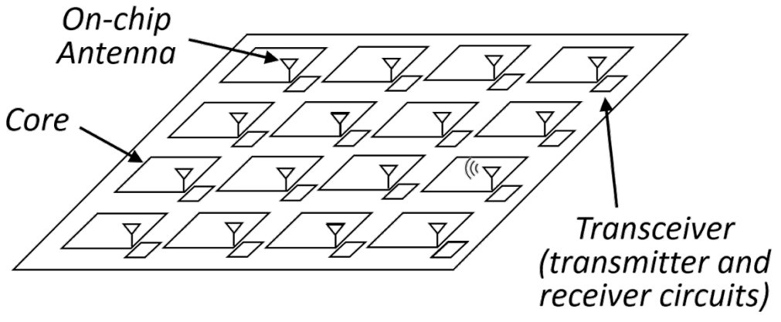
Context
Current trends are leading to larger manycores
Wireless on-chip communication holds promise for the implementation of fast networks for these multiprocessors
In complement of a wired NoC, wireless provides
Low latency
Natural broadcast capabilities
Flexibility
Notes:
The context of this work arises from the fact that current semiconductor trends are leading to larger manycores.
Wireless on chip communication holds promise for the implementation of fast networks for these multiprocessors due to the fact that when used in complement of a wired network on chip, wireless can provide a low-latency, broadcast-friendly, and flexible environment to send data across the chip

Slide 3

Related Work: Replica^{[ASPLOS ‘19]}
On-chip wireless communication for communication-intensive data
Wireless antenna and transceiver
Core
L1
L2 (LLC)
Broadcast memory
(up to 512 KB)
Notes:
Previous works, such as Replica, already took advantage of wireless on-chip communication to handle synchronization and communication-intensive data. They augmented the already existing wired network on the chip with a per-core wireless antenna and transceiver used to broadcast messages. In that design, the data being communicated through the wireless network resides in a dedicated segment of memory, called (CLICK) the broadcast memory

Slide 4
Related Work: Replica^{[ASPLOS ‘19]}
On-chip wireless communication for communication-intensive data
Core0
…
b=1
…
Core15
…
b=1
…
Core3
…
b=1
…
Master Thread​
… barrier_wait(b)
…
Notes:
The idea behind Replica is that all broadcast memories in the chip contain the same data, and any update to the data that we allocate in it, is broadcasted across the chip in about 5 cycles. As an example, imagine a (CLICK) master thread running on Core0, and (CLICK) two worker threads running on Cores 3 and 15. In this example, the data allocated in the broadcast memory corresponds to (CLICK) barrier B.

Slide 5
Related Work: Replica^{[ASPLOS ‘19]}
On-chip wireless communication for communication-intensive data
Core0
…
b=0
…
Core15
…
b=1
…
Core3
…
b=1
…
Master Thread​
… barrier_wait(b)
…
Notes:
When the master thread arrives at the barrier, it tentatively updates its value and passes it along to the local wireless transceiver.

Slide 6
Related Work: Replica^{[ASPLOS ‘19]}
On-chip wireless communication for communication-intensive data
Core0
…
b=0
…
Core15
…
b=0
…
Core3
…
b=0
…
Master Thread​
… barrier_wait(b)
…
Notes:
The transceiver then sends a broadcast message across the chip, which updates all copies of the barrier at once.

Slide 7
Related Work: Replica^{[ASPLOS ‘19]}
Challenges:
Bounded size of the broadcast memory (BMem)
Arbitrary data structures do not fit
Need profiling tools to identify what data to put in BMem
BMem area/energy overhead (≈ size L2 cache)
BMem data is replicated to all cores
Notes:
While Replica showed that using wireless for communication-intensive data can significantly speed up applications, it also arose some challenges, (CLICK) such as the bounded size of the broadcast memory, which leads to arbitrary data structures to not fit, (CLICK) the need for programmers to run profiling tools to identify what data to put in the broadcast memory, (CLICK) the area and energy overhead of the per-core broadcast memories, which is similar to the size of the L2 cache, (CLICK) and the inefficient space usage of having the same replicated data across all cores

Slide 8
Contribution: WiDir
WiDir: a directory cache coherence protocol augmented with wireless transactions for highly shared data
2 networks (wired mesh + wireless), 1 directory
WiDir leverages per-line directory info to identify highly-shared data
WiDir uses an additional state called Wireless
Unified memory hierarchy. No BMem needed
Cache lines dynamically transition wired⟺wireless based on access pattern
Transparent to programmer
Notes:
To tackle those challenges, we propose WiDir. (CLICK) WiDir is a directory cache coherence protocol augmented with wireless transactions for highly shared data. This unifies the usage of both wired and wireless networks in a single distributed directory and protocol. (CLICK) WiDir leverages per-line directory information to identify highly-shared data, so that programmers don’t have to manually identify and tag wireless candidates anymore. (CLICK) The WiDir cache coherence protocol uses an additional state called Wireless. Because in widir we have a unified memory hierarchy we do not need broadcast memories anymore, nor need to worry about their bounded size. (CLICK) In WiDir, cache lines can dynamically transition from wired to wireless states based on the access pattern, and in a programmer-transparent manner

Slide 9
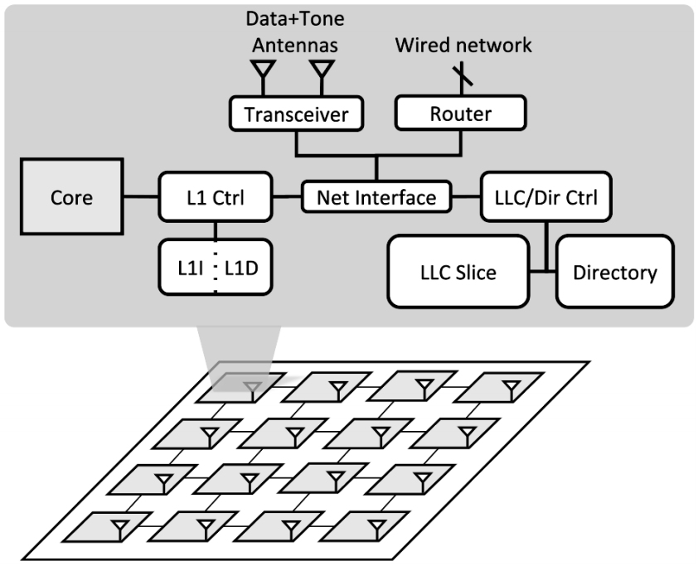
WiDir Architecture
Transceiver: modulates packet bits into wireless signals and back
Data+Tone Antennas: data channel used for data transmission; tone channel used for acknowledgement (ACK) mechanism
Notes:
The WiDir architecture augments each core with (CLICK) 2 antennas and a transceiver. These are connected to a (CLICK) network interface with access to the private L1 cache as well as to the local slice of the last-level-cache and directory. (CLICK) The transceiver is in charge of modulating packet bits into wireless signals and back, whereas the (CLICK) 2 antennas serve 2 different purposes. On the one hand, the data channel is used for data transmission, and in the other hand the tone channel is used for a fast acknowledgement mechanism that we also propose and explain in detail in the paper.

Slide 10
WiDir: Switching Wired⟹Wireless
Baseline problem: limited number of sharer pointers
If sharers overflow, set broadcast bit. If a write comes, invalidate everyone
WiDir solution: if sharers overflow, switch to Wireless state
Then repurpose sharers pointers into sharers counter (SharersCount) to track number of sharers for the line
Every time a node is added to wireless pool → directory increments SharersCount
If a write comes, broadcast updated word through wireless
Notes:
Because the number of sharer pointers is limited, in the baseline if we have more sharers than pointers, the directory must assume that all cores might have the line, and therefore it sets the so-called broadcast bit of the line to 1. This way if later-on a write request comes to a line that has the broadcast bit set to 1, the directory must invalidate everybody; this is a costly procedure. (CLICK) In contrast, with Widir, once the number of sharers goes above a certain value and we cannot keep any more pointers, the system changes to wireless state and the pointer bits change their purpose to count the number of sharers for the line. (CLICK) Every time a node is added to the wireless pool, the directory increments this counter. (CLICK) If a write comes, we broadcast the updated word through wireless to all other sharers

Slide 11
WiDir: Switching Wired⟸Wireless
Problem: if the line is not highly shared anymore, wireless broadcasts are counterproductive
Wireless bandwidth is limited. Contention must remain as low as possible
WiDir solution: Use update counter (UpdateCount) to track number of local accesses to wireless lines
Every time a node receives a wireless update → increments local UpdateCount
When the node accesses the line → resets UpdateCount to 0
If UpdateCount reaches threshold → cache invalidates line and notifies directory
When directory receives notification → decrements SharersCount
If SharersCount below threshold → directory broadcasts message to all sharers, and switch back to wired Shared state
Notes:
Something to also take into consideration though is that if a line is not highly shared anymore, wireless broadcasts are counterproductive, since the wireless bandwidth is limited, and contention must remain as low as possible. (CLICK) Our solution for that is to have an update counter per cache line to track the number of local accesses to wireless lines. (CLICK) This way every time a node receives a wireless update it increments the counter by 1, (CLICK) and every time the node accesses the line it resets it back to 0. (CLICK) If the counter ever reaches a certain threshold, the line is assumed to not be consumed anymore, and therefore it is invalidated locally. In this case the node notifies the directory, (CLICK) so that this one decreases the sharers counter by 1. (CLICK) If at some point the sharers counter goes below a certain threshold, it is assumed that the line is not a good candidate for wireless anymore, and a downgrade message is broadcasted to all remaining sharers, so that they all can switch back to the wired shared state.

Slide 12
WiDir: Evaluation Methodology
Cycle-level architectural simulations using SST
64 out-of-order cores
Inclusive 2-level cache
2D mesh wired network (1 cycle/hop) + wireless network (20 Gbps)
Applications
20 benchmarks from SPLASH-3 and PARSEC suites
Multiple domain: Scientific computing, computer vision, kernels, etc.
Notes:
Moving on to the evaluation section, we implemented widir in a cycle-level architectural simulator, called SST, with up to 64 out of order cores, an inclusive 2-level cache, and a hybrid wired mesh with 1 cycle per hop, combined with a wireless network operating at 20 gbps. We obtained results from 20 benchmarks of the splash-3 and parsec suites, representing applications from multiple domains, such as scientific computing and computer vision

Slide 13
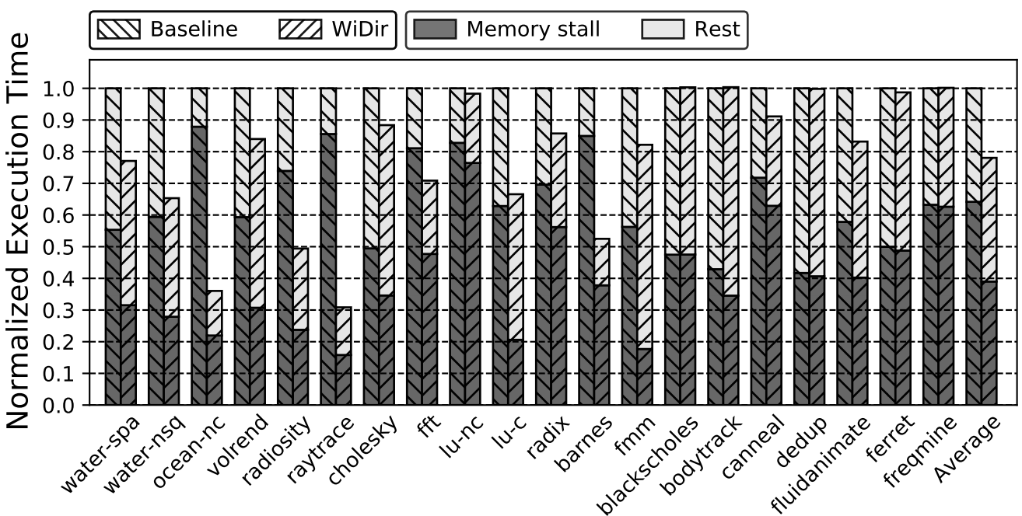
WiDir: Execution Time
22%
In Baseline, many cycles are wasted to memory stalls
WiDir reduces mem stall cycles in many applications (1/3 on average)
Notes:
This plot compares the execution time in baseline and widir, for different applications. For each application we show a bar for the baseline and one for widir. The bars are broken down into the contributions of the memory stalls, and the rest, and they’re normalized to the baseline. Looking at the applications we see that in the baseline, many cycles are wasted to memory stalls. Widir reduces these memory stalls by 1/3 on average. As a result, the average execution time on widir is reduced by 22%.

Slide 14
WiDir: Also in the Paper…
Description of all possible state transitions
Acknowledgment mechanism
Jamming mechanism
Further analysis on…
Data sharing
Cache misses
Distribution of wired network hops
Power, energy and area consumption
Sensitivity of architectural parameters
Scalability
Notes:
Please refer to the paper for more details on the implementation of the widir protocol, the acknowledgment and jamming mechanisms, as well as a further analysis on…

Slide 15
WiDir: Conclusions
WiDir is a directory cache coherence protocol augmented with wireless transactions for highly shared data
Leverages per-line directory information to identify highly-shared data
Uses an additional state called Wireless to update sharers upon a write
Has 2 networks (wired+wireless) and a single distributed directory
Lines dynamically transition wired⟺wireless based on access patterns
Thank you!
Presenter: Antonio Franques – franque2@illinois.edu
This presentation and recording belong to the authors. No distribution is allowed without the authors' permission.
Notes:
To conclude this presentation and to summarize, in this paper we proposed Widir. Widir is a novel directory cache coherence protocol, augmented with wireless transactions for highly shared data. (CLICK) Widir leverages per-line directory information to identify highly-shared data. (CLICK) Widir uses an additional state called Wireless to update sharers upon a write. (CLICK) Widir has 2 networks (a wired and a wireless), and a single distributed directory. (CLICK) Lines in widir dynamically transition between wired and wireless based on access patterns. (CLICK). Thank you for your attention and please do not hesitate to post any questions.

